Slide 1

RUNGTA COLLEGE OF DENTAL SCIENCES AND RESEARCH
MYOCARDIAL INFARCTION
DEPARTMENT OF GENERAL MEDICINE

Slide 2
SPECIFIC LEARNING OBJECTIVES
MUST KNOW | NICE TO KNOW | DESIRE TO KNOW
PATHOPHYSIOLOGY | DIAGNOSTIC EVALUATION | INTRODUCTION
CAUSES | COMPLICATION | NURSING PROCESS
CLINICAL MANIFESTATIONS
MANAGEMENT

Slide 3
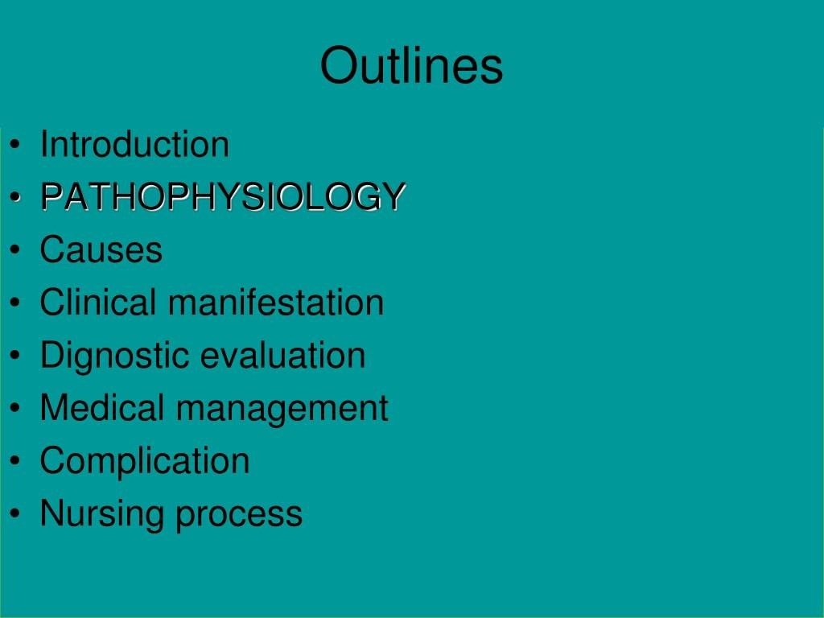

Slide 4
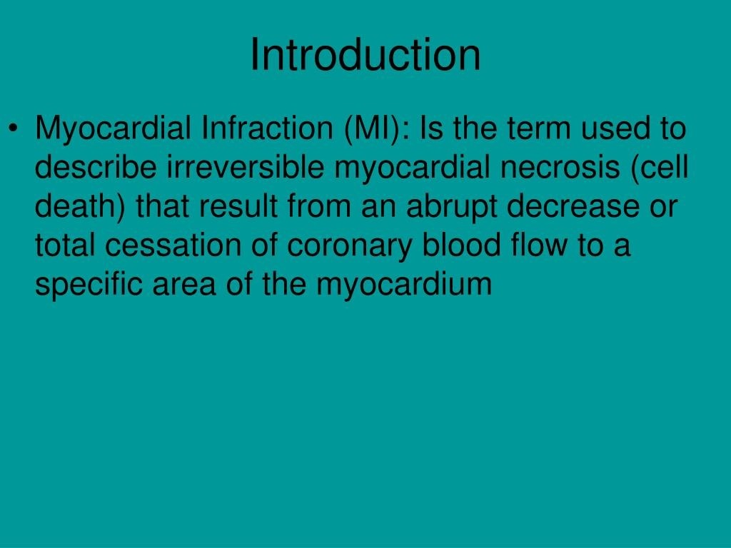

Slide 5
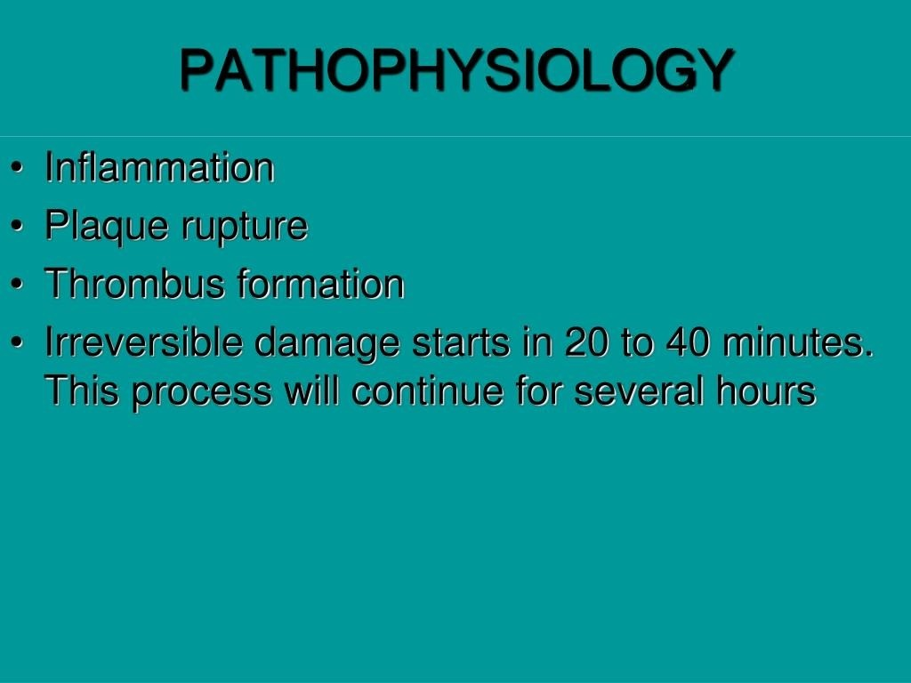

Slide 6
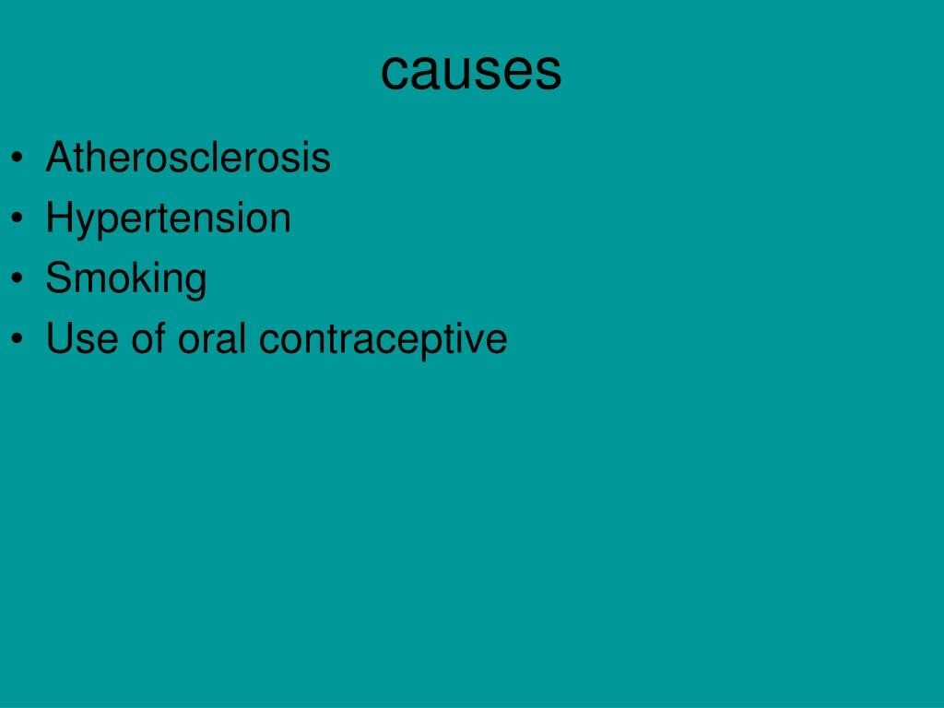

Slide 7
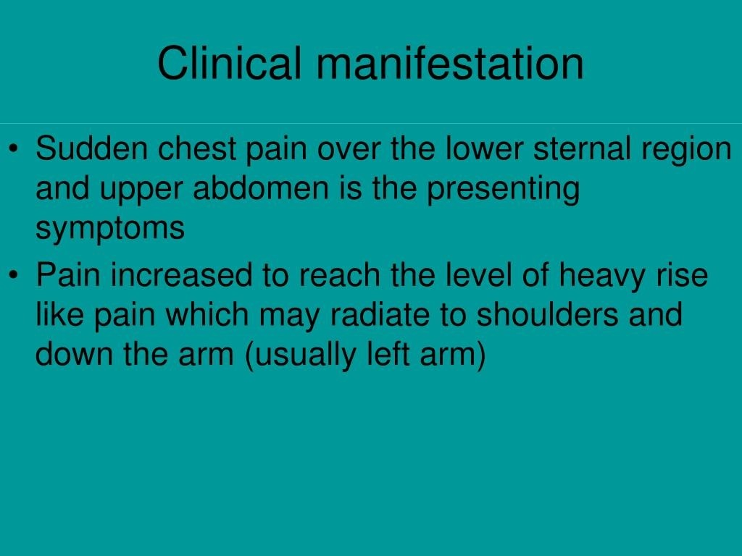

Slide 8
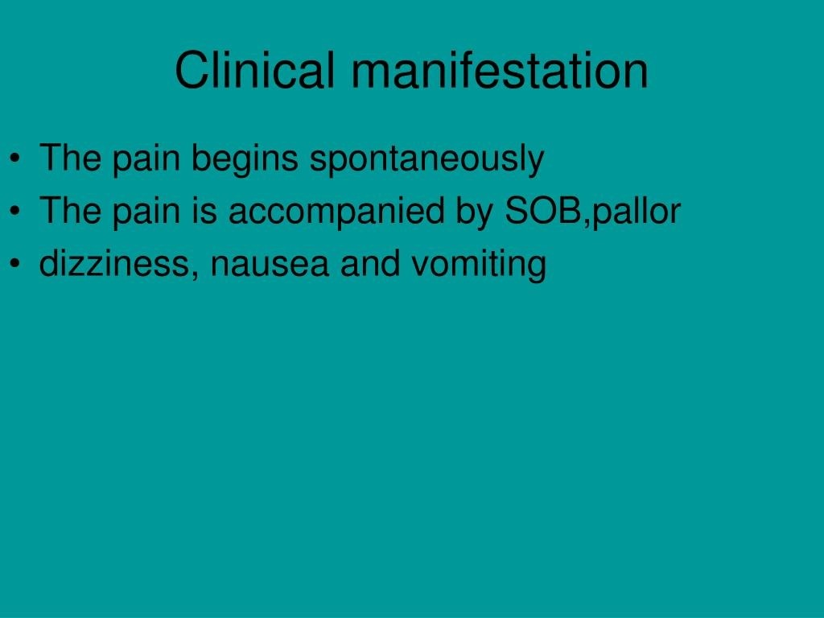

Slide 9
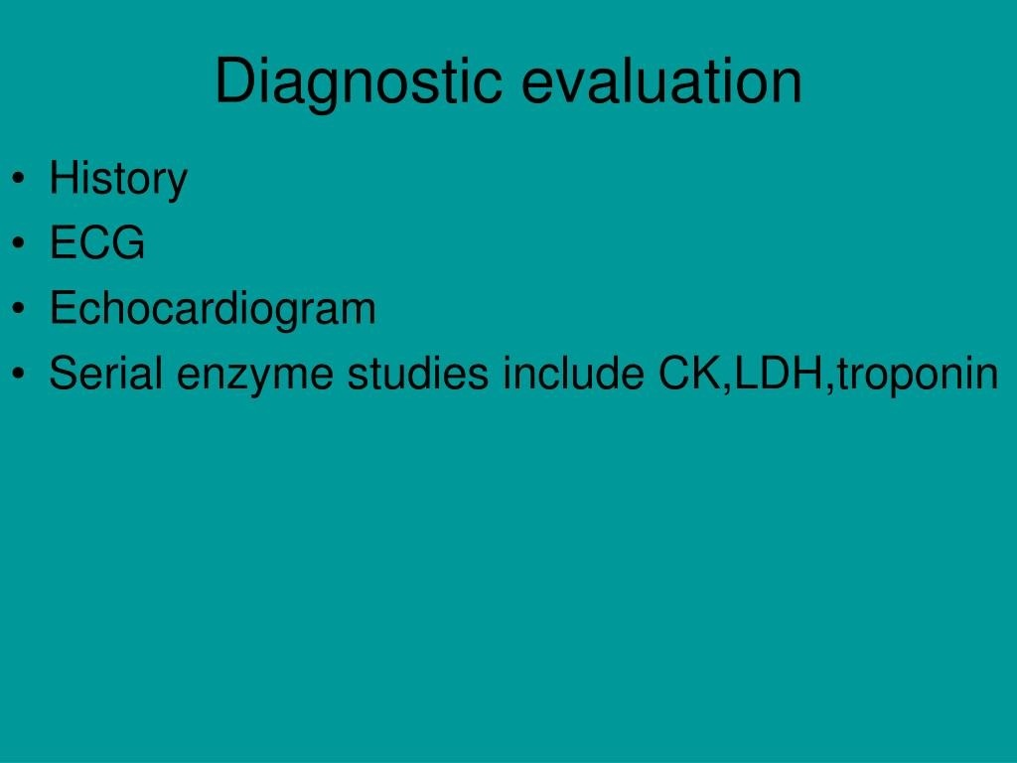

Slide 10
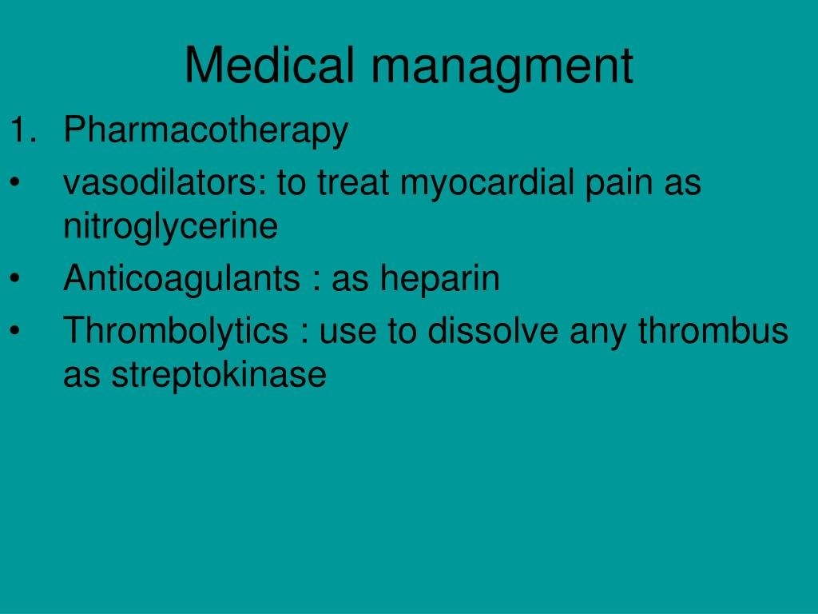

Slide 11
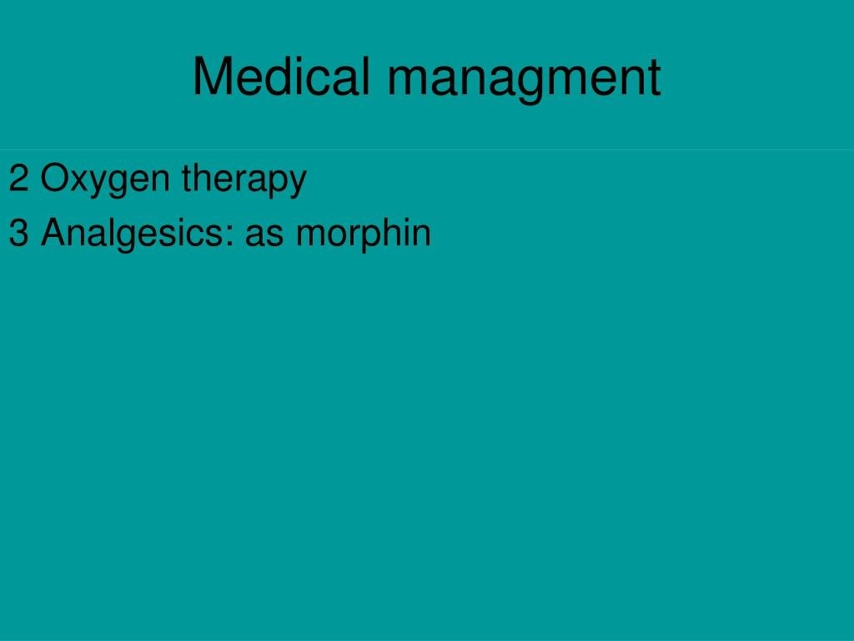

Slide 12
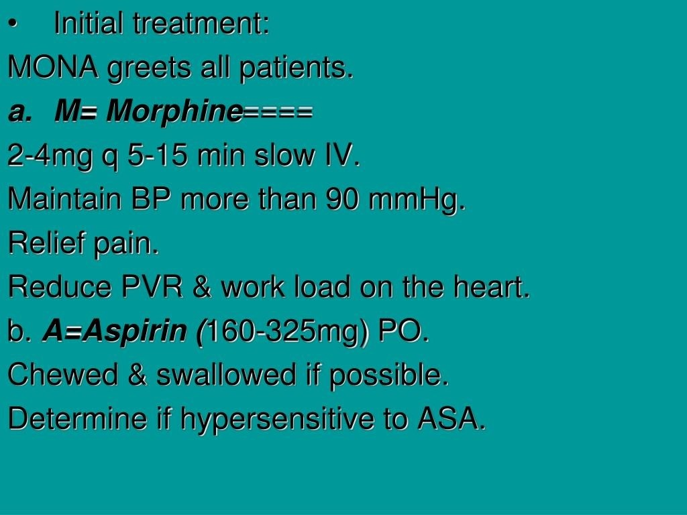

Slide 13
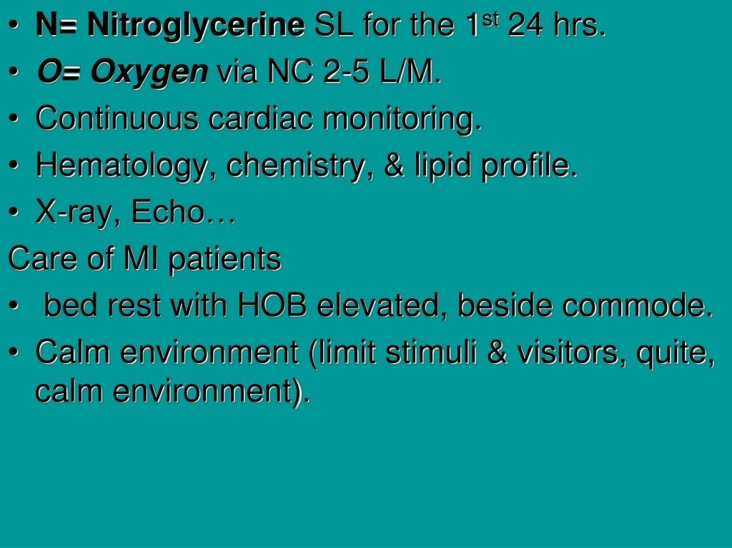

Slide 14
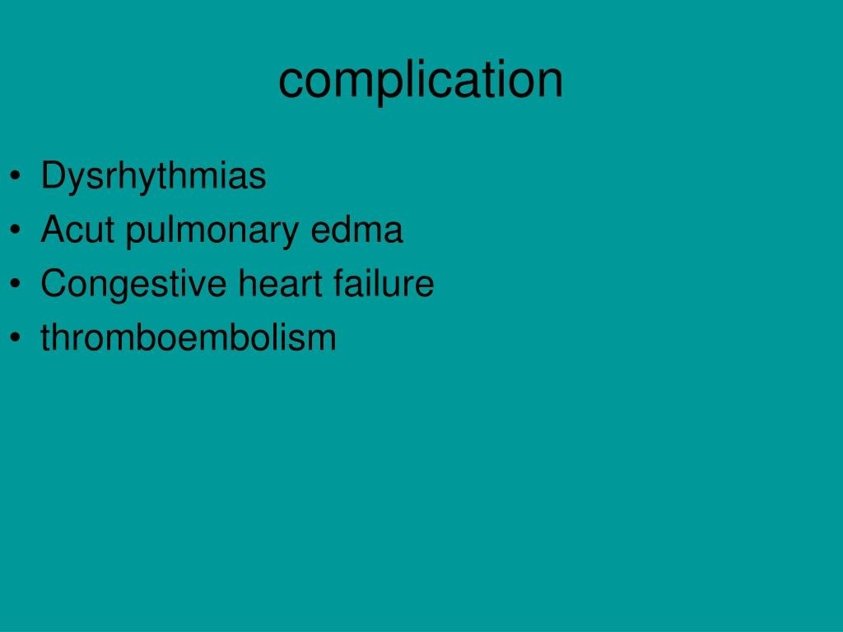

Slide 15
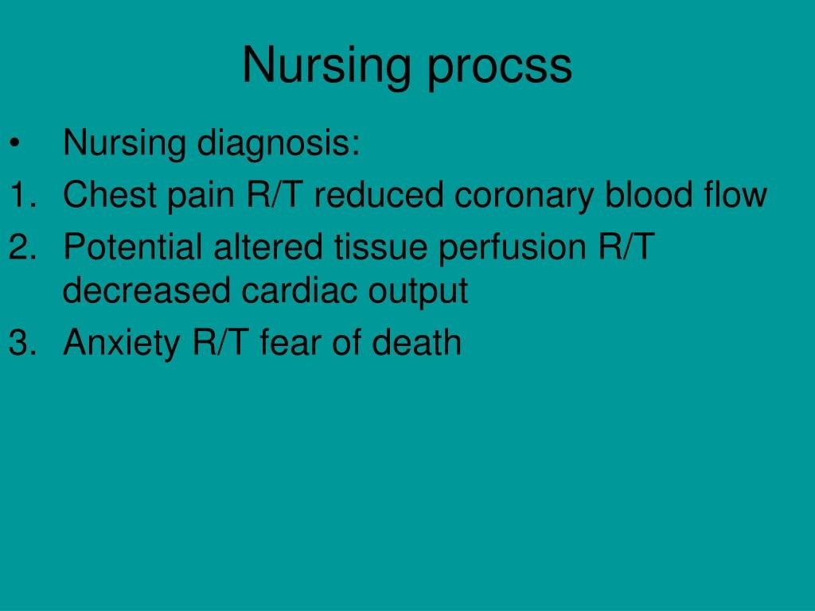

Slide 16
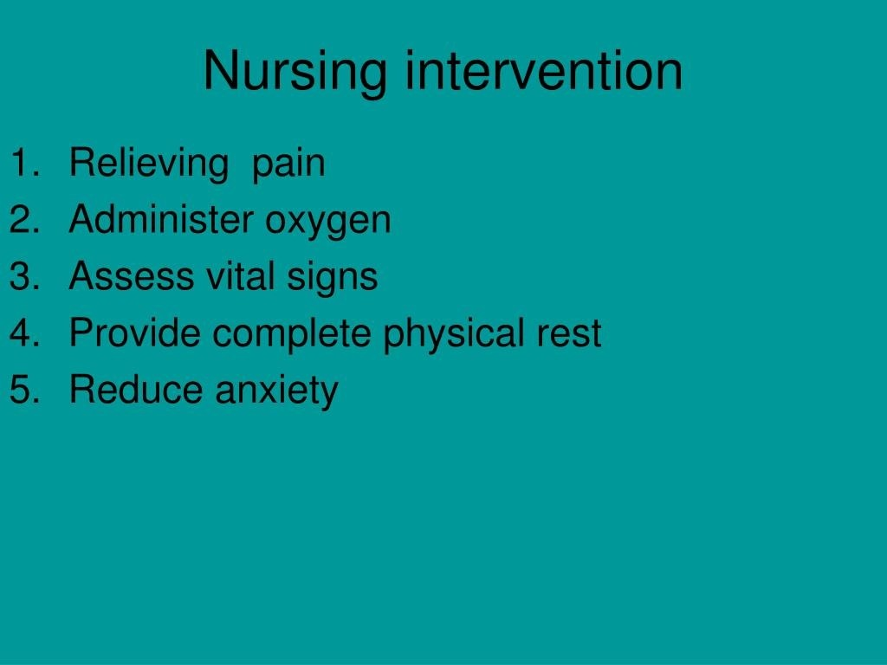

Slide 17
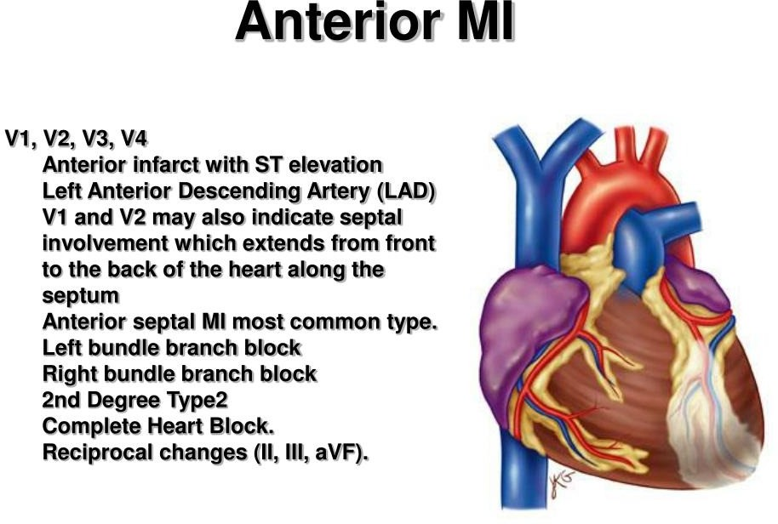

Slide 18
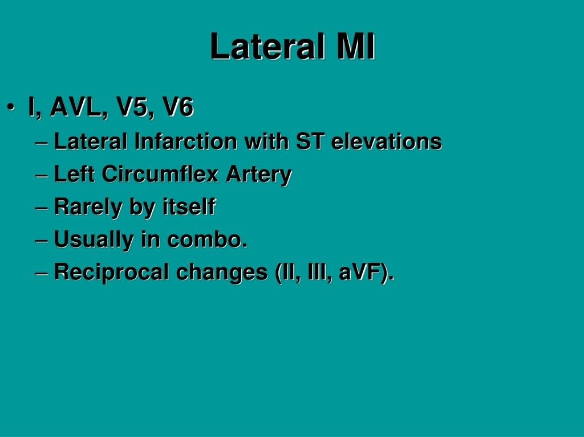

Slide 19
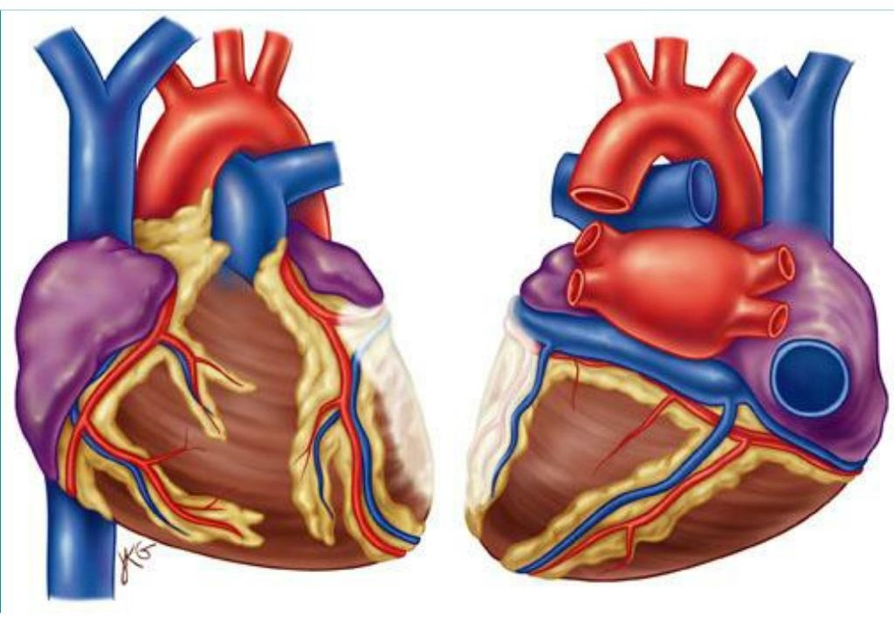

Slide 20
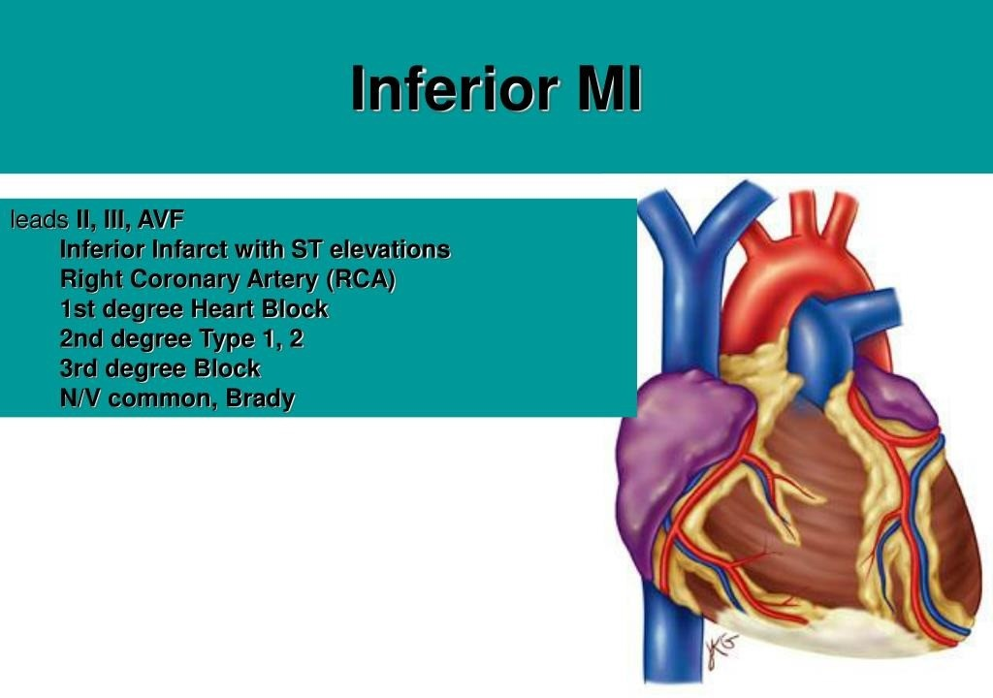

Slide 21
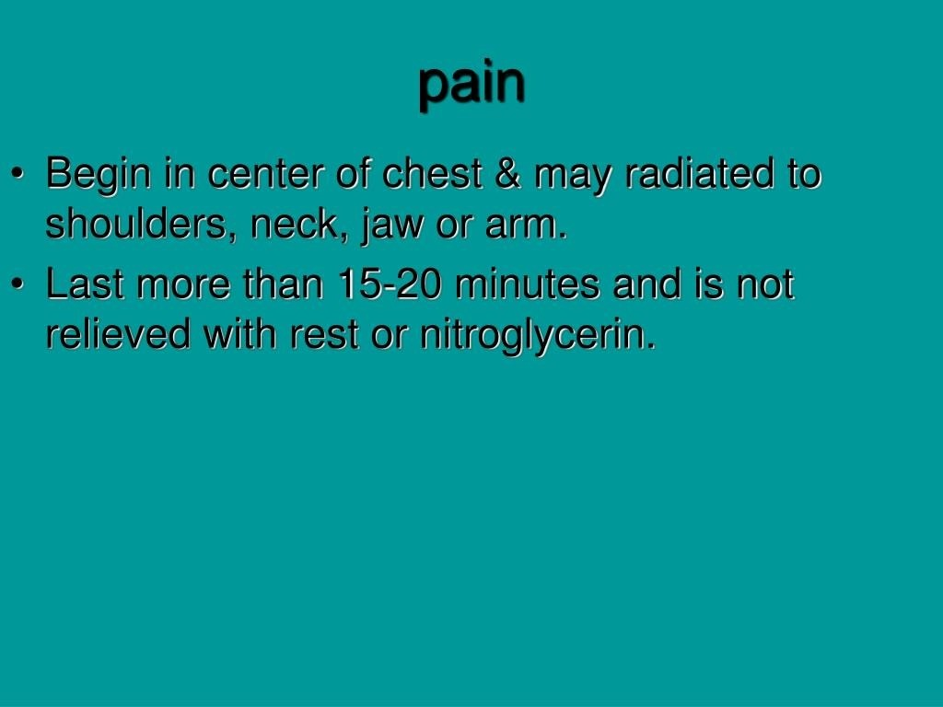

Slide 22
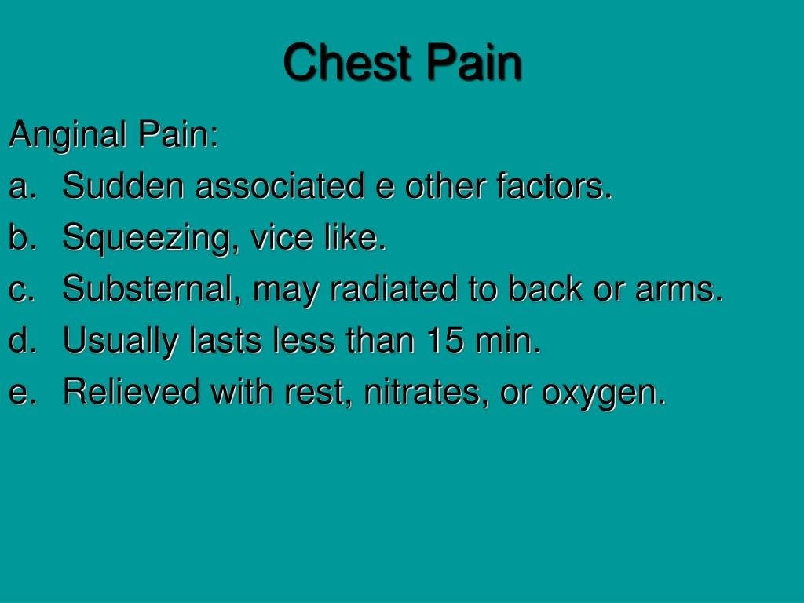

Slide 23
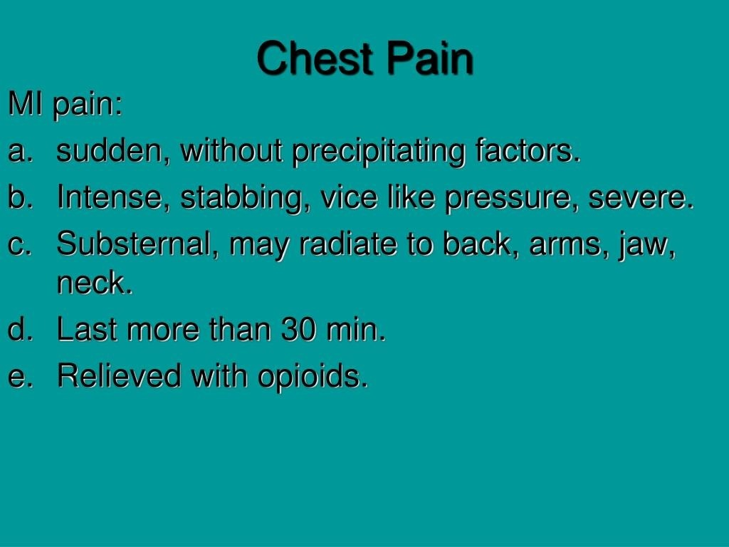

Slide 24
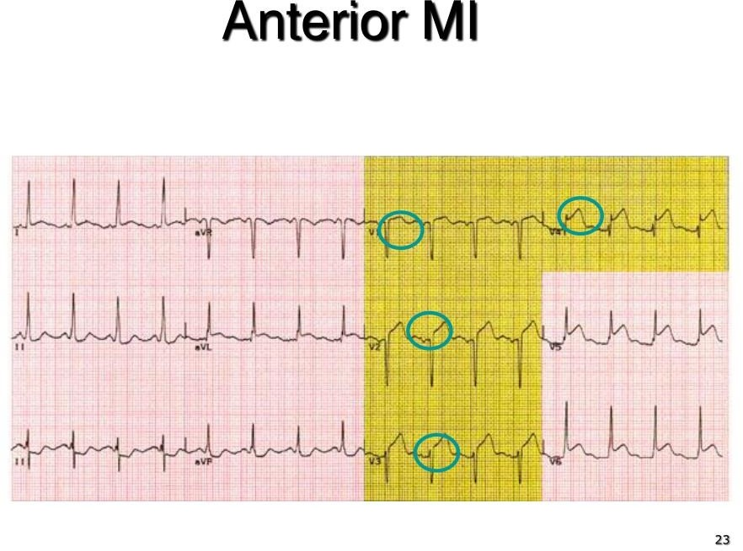

Slide 25
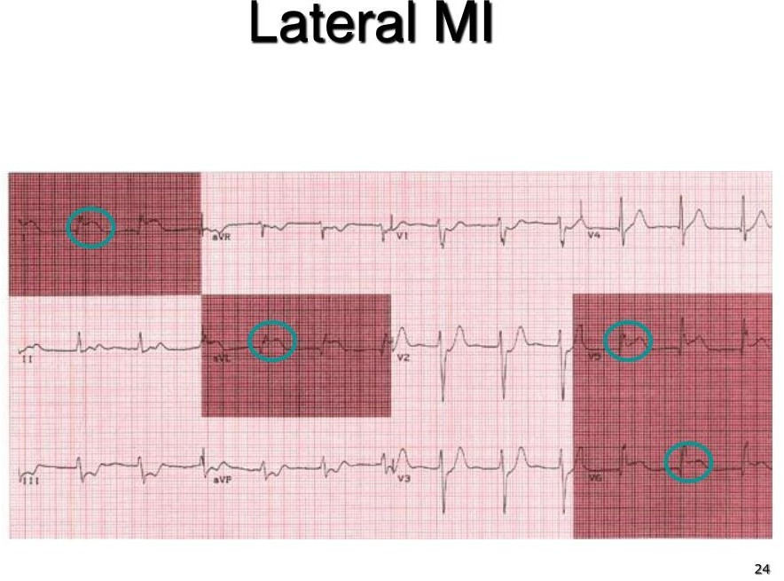

Slide 26
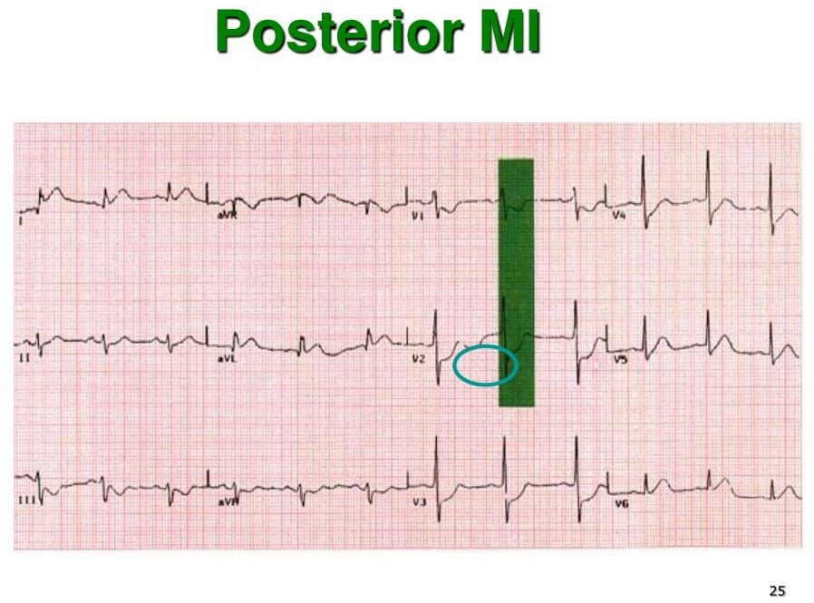

Slide 27
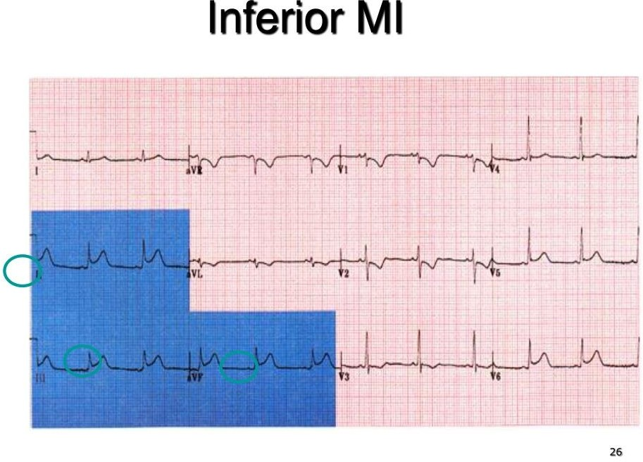

Slide 28
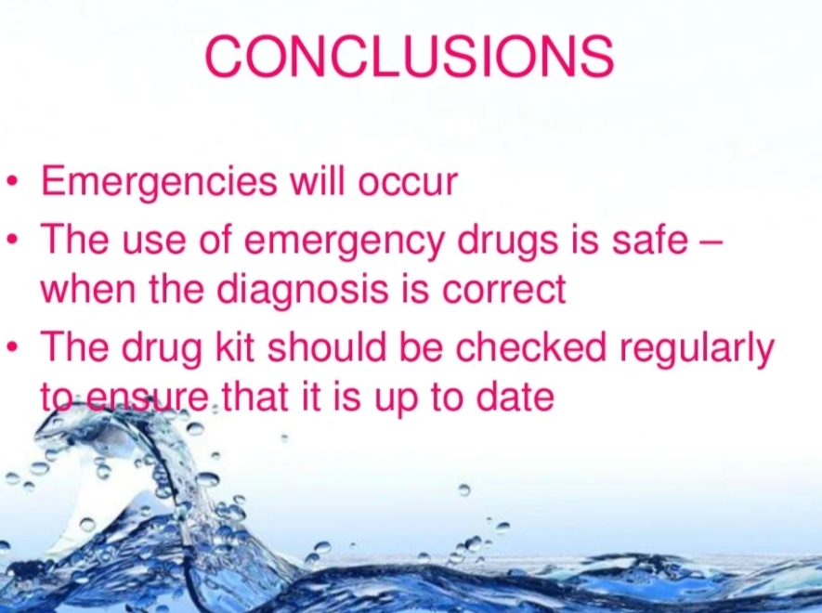

Slide 29
REFERENCES
DAVIDSON’S PRINCIPLES AND PRACTICE OF MEDICINE; 23rd edition
HARRISON’S PRINCIPLE OF INTERNAL MEDICINE; 21ST edition
TEXTBOOK OF CLINICAL MEDICINE by S.N Chugh ;5th edition

Slide 30
QUESTION AND ANSWERS

Slide 31
THANK YOU....

